Slide 1
Bike-Share Navigate Speedy Success?
Cyclistic Case Study: Capstone Project 1

Slide 2
The Case Study:
The director of marketing Lily Moreno, believes the company’s future success depends on maximizing the number of annual memberships. Therefore, Cyclistic marketing analytics, Cyclistic executive team wants to understand how casual riders and annual members use Cyclistic bikes differently.
Current problem Faced by Ms. Lily Moreno
Lack of knowledge of Customer Preference.
Need to study Cyclistic historical bike trip data to identify trends.
Lack of digital Media Marketing
Looking at the Problem, Ms. Lily Moreno has a team pulled in on-board.

Slide 3
Characters and Teams
Lily Moreno: The director of marketing
Cyclistic marketing analytics team: A team of data analysts
Cyclistic executive team: The notoriously detail-oriented executive team
Cyclistic: A bike-share program that features more than 5,800 bicycles and 600 docking stations.

Slide 4
Background
In 2016, Cyclistic launched a successful bike-share offering. Since then, the program has grown to a fleet of 5,824 bicycles that are geotracked and locked into a network of 692 stations across Chicago. The bikes can be unlocked from one station and returned to any other station in the system anytime.
There are two types of Cyclists: Memberships and Casual
Customers who purchase single-ride or full-day passes are referred to as casual riders. Customers who purchase annual memberships are Cyclistic members.

Slide 5
Decode the Case Study:
Project Idea: Design marketing strategies aimed at converting casual riders into annual members.
Current Need: data, Marketing tactics, general awareness and appealing to broad consumer segments.
Overview of the project: It’s an Cyclistic based Project. Current Project need some inputs that will guide the future marketing program.
Current Problems: better understand Customer wants, marketing tactics, bike trip data to identify trends.

Slide 6
Case Study RoadMap-Ask
1. How do annual members and casual riders use Cyclistic bikes differently?
2. Why would casual riders buy Cyclistic annual memberships?
3. How can Cyclistic use digital media to influence casual riders to become members?

Slide 7
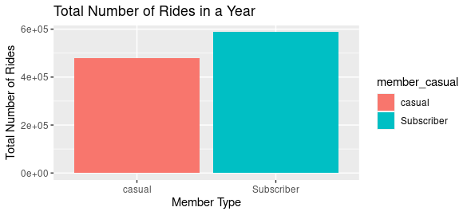
How do annual members(Subscriber) and casual riders use Cyclistic bikes differently?
This image illustrates that throughout the year, Subscribers or Members tends to use the total number of ride more frequently than Casual Riders

Slide 8
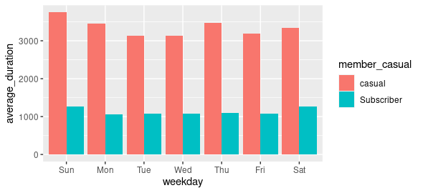
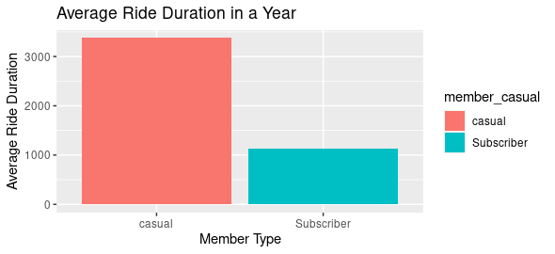
How do annual members(Subscriber) and casual riders use Cyclistic bikes differently? Average Duration in Weekday & Year! This image illustrates that average duration in a Weekday & Year, Casual Riders tends to use the total number of ride more frequently than Subscribers or Members.

Slide 9
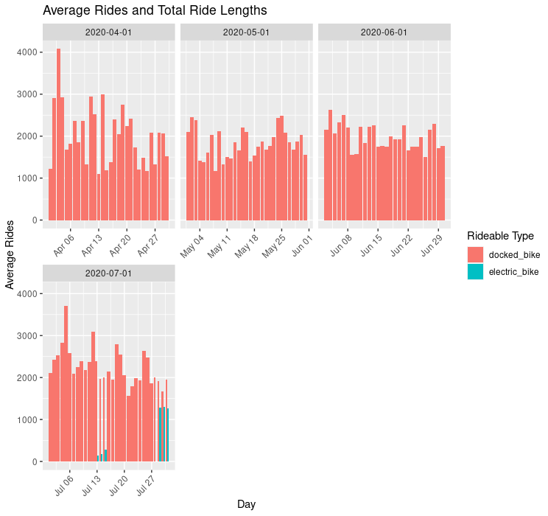
How do annual members(Subscriber) and casual riders use Cyclistic bikes differently?
This image illustrates that average duration Ride in a Monthly & Yearly, Docked bike Riders tends to use total number of ride more frequently than electric bike.

Slide 10
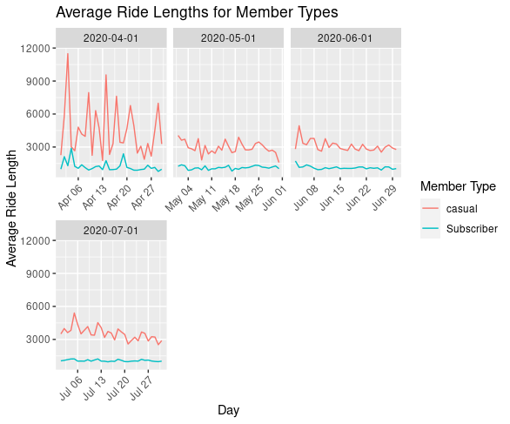
How do annual members(Subscriber) and casual riders use Cyclistic bikes differently?
This image illustrates that average duration Ride in a Monthly & Yearly For Members Types , Casual member tends to use total number of ride more frequently than Subscriber or Members.

Slide 11
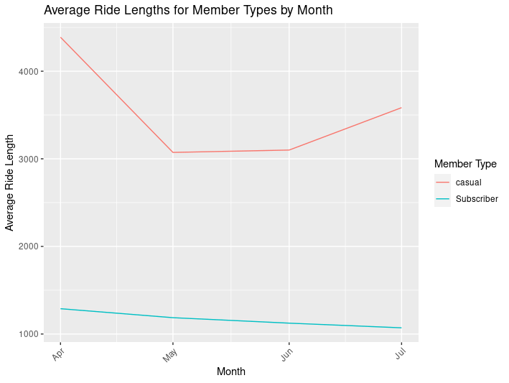
Why would casual riders buy Cyclistic annual memberships? Overall, Total Average ride of Casual Member is higher in weekday, Monthly and Yearly.

Slide 12
Why would casual riders buy Cyclistic annual memberships? According to data, Total Average ride of Casual Member is higher in weekday, Monthly and Yearly. Project Idea: Design marketing strategies aimed at converting casual riders into annual members. Decision to purchase casual rider into annual members may depends on various factors:
Cost Saving
Convenient
Membership Perk
Commitment to health and Fitness
Membership Promotion
Group Ride and Events
Improved Riding skill
Access to Resources
Implementing targeted marketing strategies to encourage casual riders to transition into annual memberships has the potential to enhance the company's profitability.

Slide 13
Thankyou

